Slide 1

Plantastic
Dylan Loers, Lisa Curvers, Marco Jacobs,
Nadia Spapens & Tevin Sanchez
Notes:
Guidline:
Good afternoon everyone, we are Plantastic, my name is Dylan (give the rest the time to introduce themselves). Our plan is to design A cheap, compact and easy to use CNC router for the masses. What is a CNC router you may ask yourself, A CNC router is a machine which is used for cutting different materials such as but not limited to, wood, plastic and foams.

Slide 2
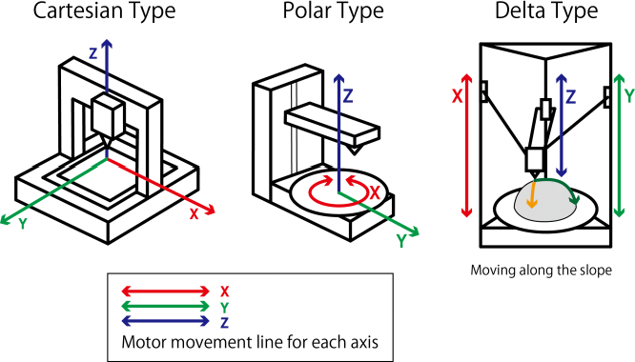
Movement
Stepper Motor
30cm / 42cm

Slide 3
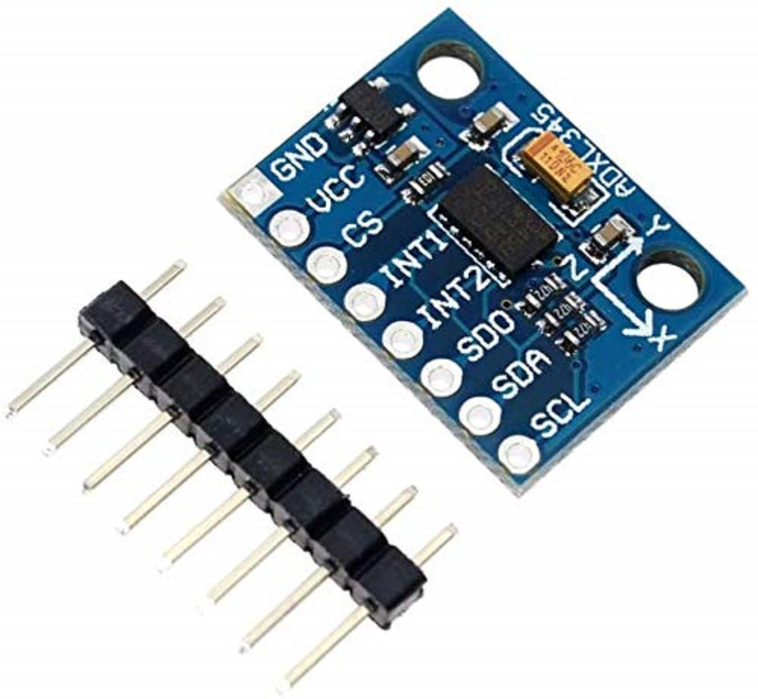
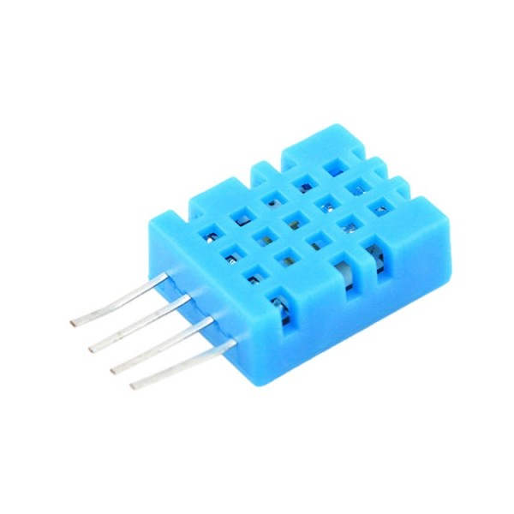
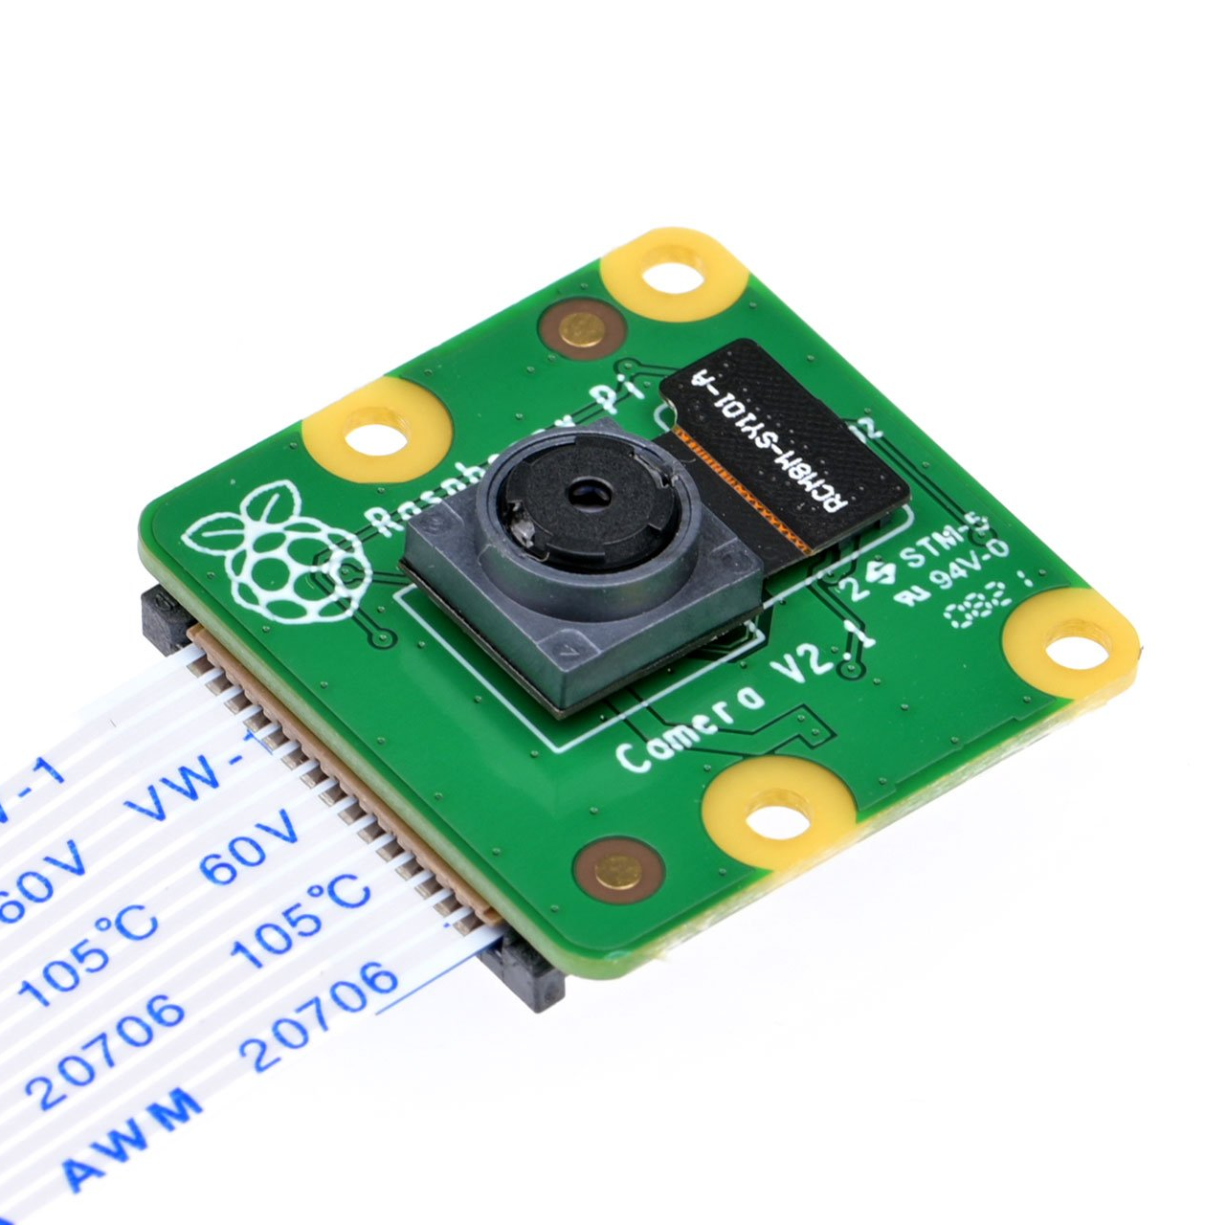
Sensors
Accelerometer
Temperature
Camera

Slide 4
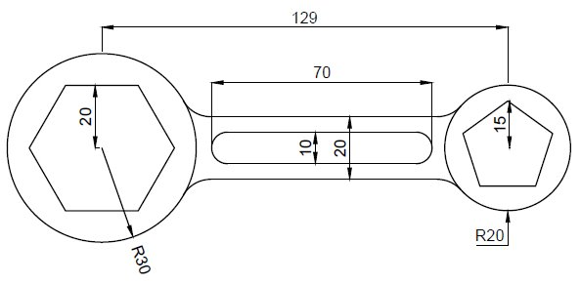
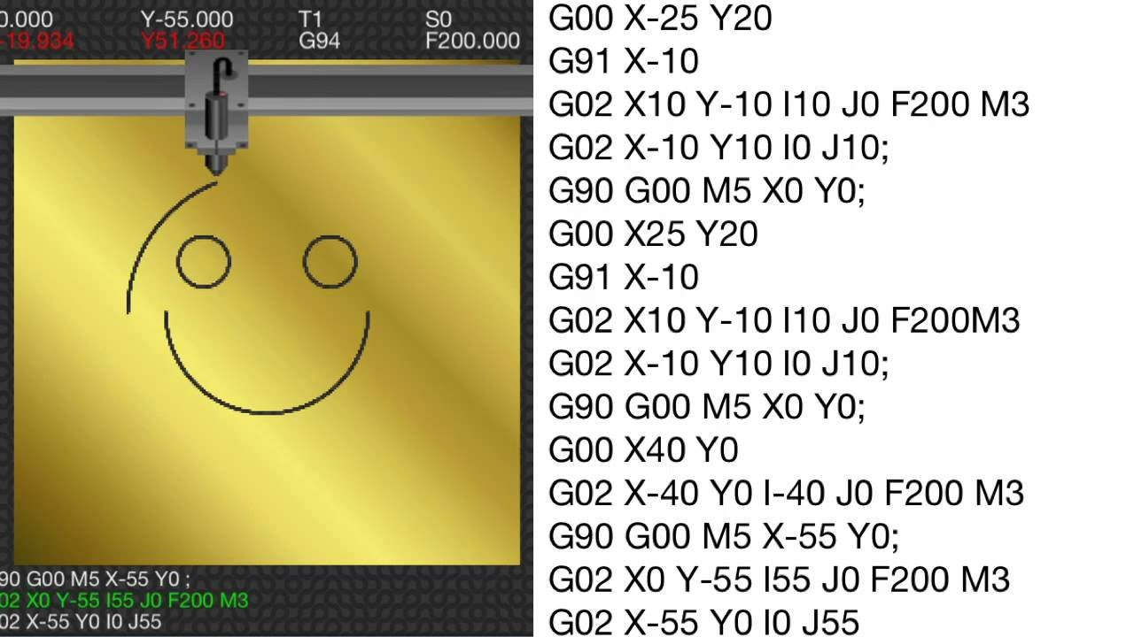
CAD File and G-Code
Notes:
CAD file is Computer Aided Design and is used for models and architectural plans mostly, after that, they will be made into G-Code and we will use a protocol to translate the G-Code into movement. We’re thinking about making a protocol to translate the G-Code to actual movement.

Slide 5
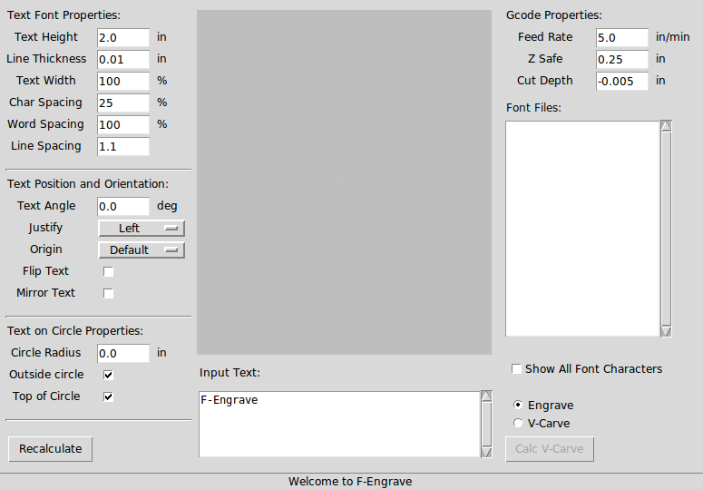
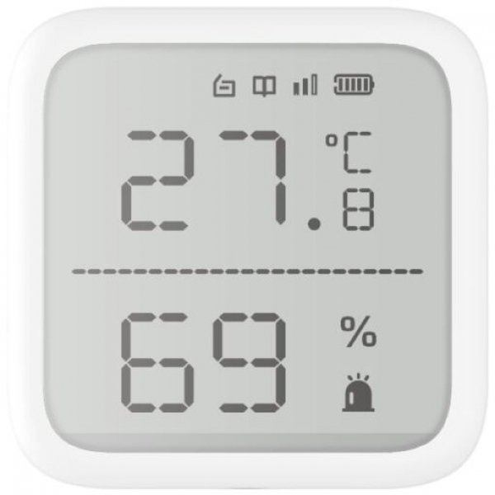
User interface
Build for simplicity.
Cam software implementation
Real time info
Monitoring capabilities
Notes:
Introducing a user interface that is as simple as everyday appliances, our focus will be on a commitment to user-friendly design.
Starting with the graphical user interface, a protocol to translate the G-code that we will use is a CAM software called F-Engrave. We will create our user-friendly application to retrieve the G-code from F-Engrave and upload it to the CNC machine. Yes, it's that easy.
For us, simplicity doesn't mean limitations; instead, it means more opportunities for features. We will also include real-time data display and precise coordination. Additionally, for the rest of the user interfaces, we will add monitoring capabilities, including temperature monitoring, emergency controls, and more safety features for the user.

Slide 6
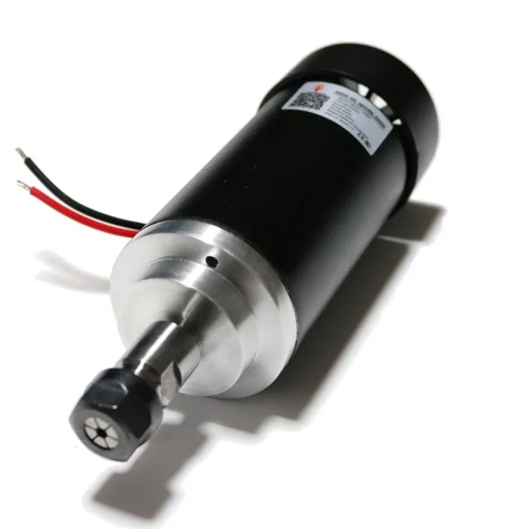
Machining head
Spindle motor
What is a Spindle motor?
Collet
What is a collet?
Tool
What are tools?
Notes:
Guideline:
So a machine head, what is it and what does it do? The machine head in our case, houses the components that removes the material. The machine head consists of 3 main components : The spindle motor, the collet and the tool.
You may ask, what is a spindle motor?
A spindle motor sometimes called a high-speed motor. There are two types of spindle motors, a belt driven spindle and a integral motor spindle. We will be using a integral motor spindle. The integral is a reliable, high speed, small and lightweight motor that is widely used and valued by related industries.
Attached to a spindle motor is a collet. Collets are a type of chuck that holds a tool. We will be using a ER collet, it is a popular and widely used clamping system. It works by using a tightening mechanism, creating clamping pressure around the tool and thus securely holding in place.
You've heard me referring to a tool, and I am not talking about myself. A tool in this case is not a wrench or drill. A tool in our case is a device clamped inside of the collet that makes a CNC machine versatile. You can compare a tool to a bit you attach to screwdriver or drills. Different tasks require different tools.

Slide 7

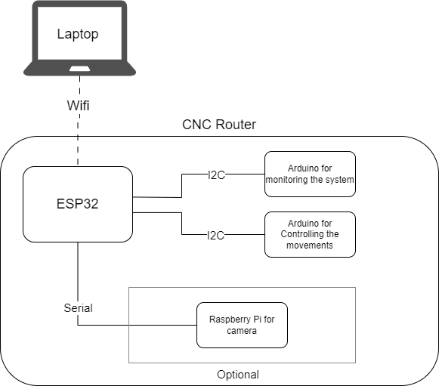
Sub systems

Slide 8
Questions?
?

